Slide 1
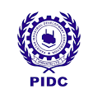
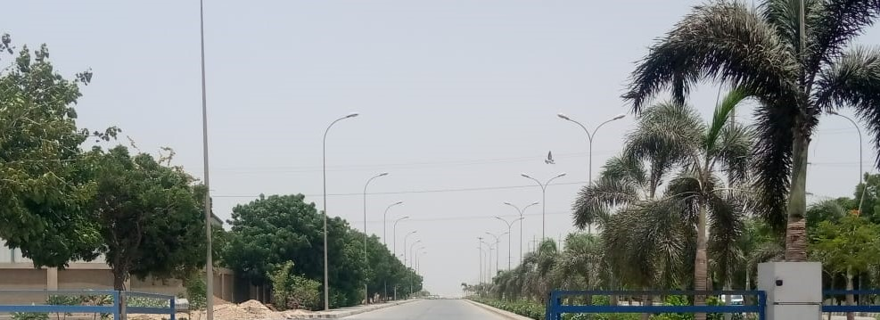
Pakistan Industrial Development Corporation (Pvt.) Ltd.
INVESTMENT OPPORTUNITIES IN
SPECIAL ECONOMIC ZONE AT
KARACHI, PAKISTAN

Slide 2
Key Fiscal Incentives for Businesses Operating in a SEZ
Income Tax Exemption: 10-year tax holiday from the date of commencement of commercial operations.
Custom Duties & Taxes Exemption: One-time exemption on import of capital goods into the SEZ; includes machinery, equipment, and accessories.
100% Repatriation of Profits

Slide 3

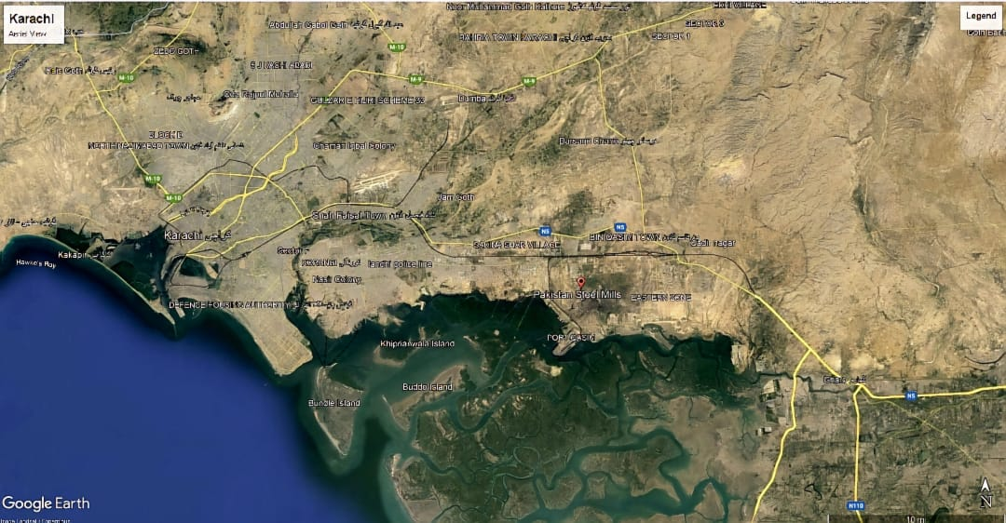






Karachi Industrial Park Accessibility
M-9
M-9
22km
Airport
Pakistan Steel
Industrial Area
25km
C
D
KIP Industrial
Land
DHA
N-5
34km
6km
N-5
Karachi Port
Port Qasim
N-5

Slide 4
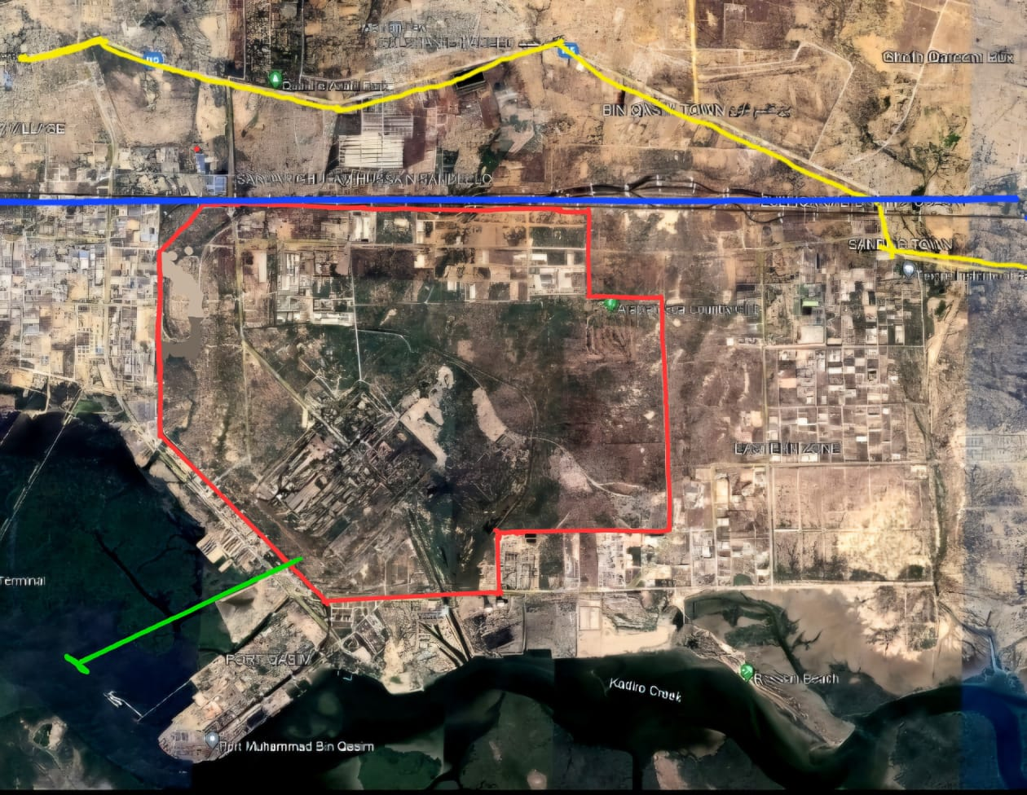
Location Map of Karachi Industrial Park
N-5
Airport 25km
Main Railway Line
PSM Industrial Land
Total: 9,348 Acres (Approx)
Available: 6,409 Acres (Approx)
C
D
PSM Jetty
Port Qasim

Slide 5
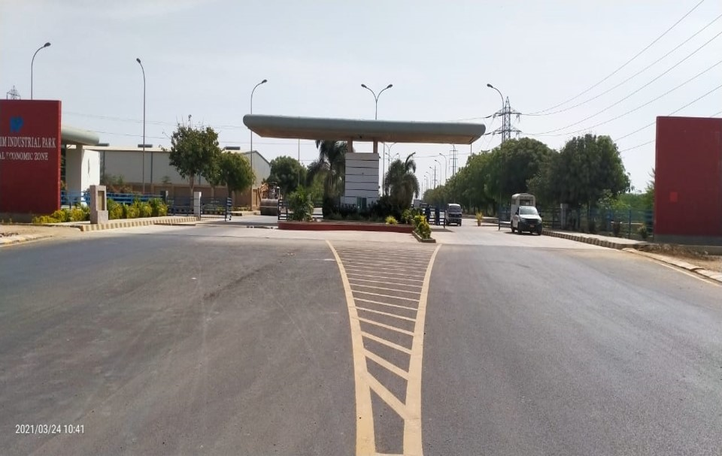
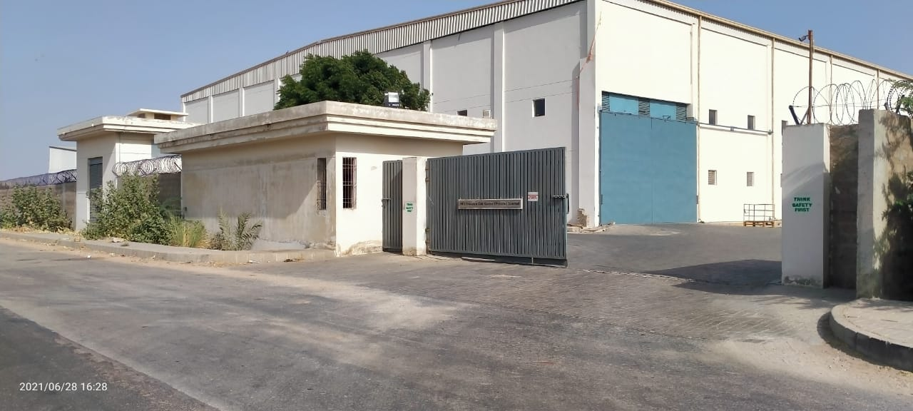
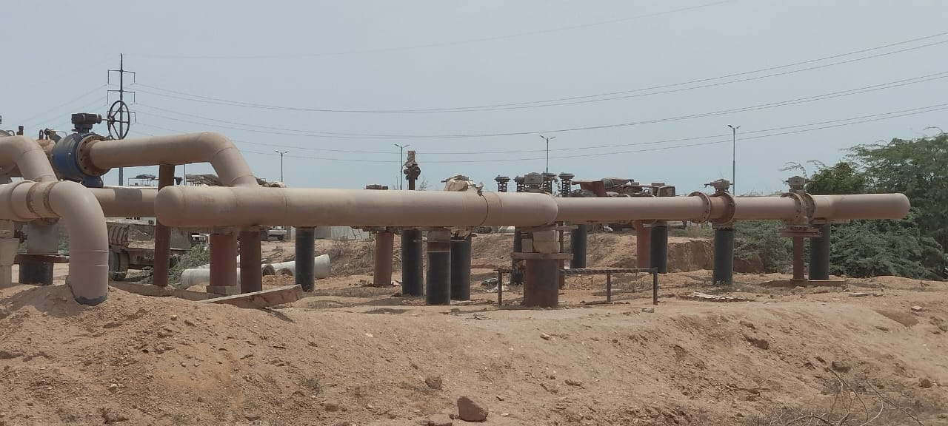
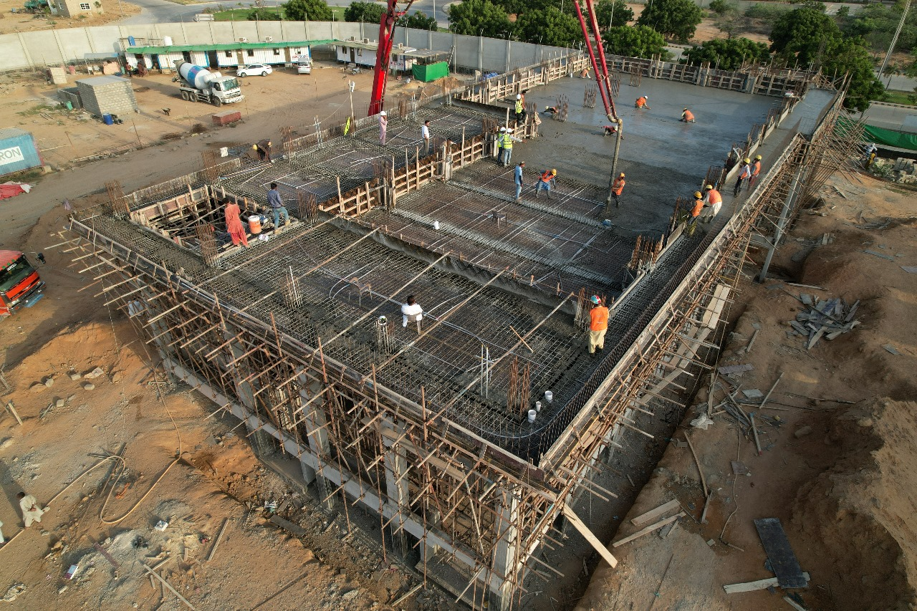
Bin Qasim Industrial Park (BQIP)
BQIP is a 930 Acres Developed and Functional Special Economic Zone (SEZ), located in the downstream industrial estate of Pakistan Steel Mills (PSM), in District Malir, Karachi.
BQIP is home to leading manufacturing concerns, namely: Lucky Motor Corp. (KIA; Peugeot; Samsung); Yamaha Motors; Tecno Auto Glass; MID Pakistan Coil; International Steel & Horizon Steel.
At BQIP utilities including Power, Gas and Water are available to meet energy requirements of industries
Over 200 Acres of Developed Land Available in Flexible sizes for investment from Turkish investors
Access Road to BQIP Entrance
Operational Industrial Unit
SSGC TBS to provide 13MMCFD RLNG
Construction of 132 kV Grid (Planned Completion in 2025

Slide 6
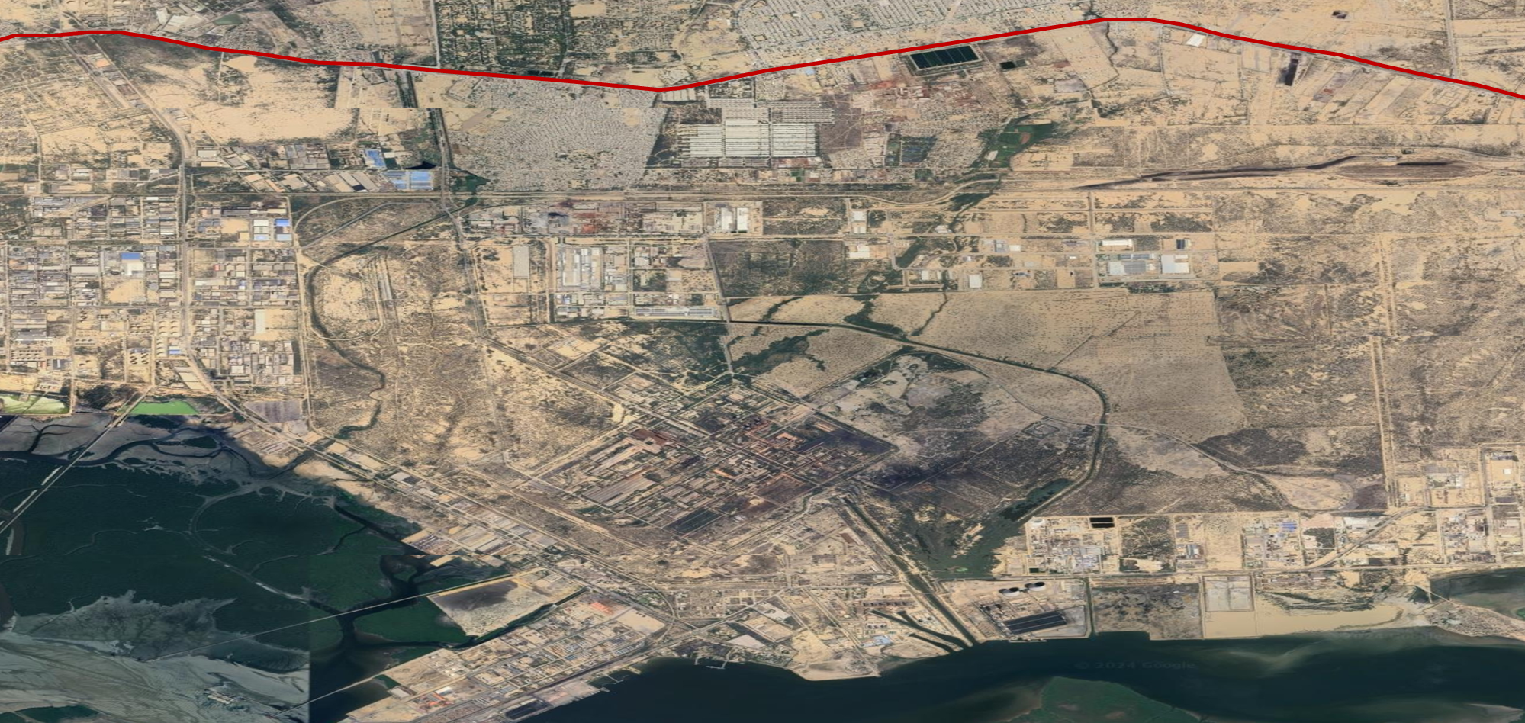
Block Diagram of Karachi Industrial Park (KIP) Location
N5 - Karachi
N5 – Dhabeji/Thatta
Arabian Sea Country Club Ltd
Leased to PQA
Downstream Industrial Estate
731 Acres
Bin Qasim Industrial Park
930 Acres
158 Acres
Subsequent 1000 acres of KIP
200 Acres
First Block of KIP
(534 acres)
PIDC
For Pak Steel Mill
700 Acres
Vacant PSM Land
4875 Acres
BQIP – 930 Acres
KIP – 1534 1st Phase
Vacant PSM Land – 4875
220
Acres
For PSM – 700
DSIE – 731
ACCL - 200
National Steel Complex Ltd
6
NSCL - 220
Port Qasim
PQA - 158

Slide 7
Karachi Industrial Park – Federal SEZ
PIDC is also Developing the first 500-Acre Block of a 6400 Acre Federal SEZ in Karachi near Port Qasim – completion 30th June 2026.
Master Plan of complete 1,534 Acres has already been prepared by a renowned consultant of industrial infrastructure, M/s Surbana Jurong Infrastructure Pte. Ltd Singapore
The Turkish Investors/Developers may choose to Develop any chunk of land within the 6400acre present a strategic opportunity for development by a Turkish investor. The Board of Investment (BoI), can provide the requisite terms and conditions to support the investment
Enterprises operating in Karachi Industrial Park can avail the same fiscal benefits as mentioned earlier (income tax exemption and exemption on duties & taxes on import of capital goods)

Slide 8
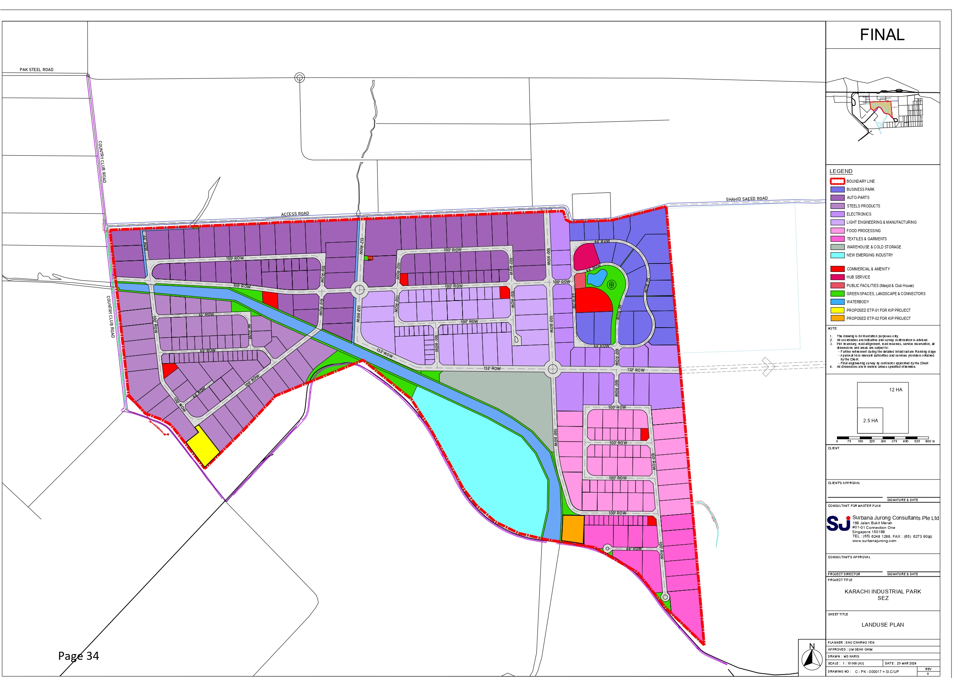
Master Plan of KIP

